Slide 1
Case Study
Milestone #4
Jacob Cannamela
Scott Hackett
Cindy Hernandez
Colton Kohler
CSD-310
12/15/2024

Slide 2
Meet Team #4
Our team consists of Jacob Cannamela, Scott Hackett, Cindy Hernandez, and Colton Kohler. We are all working towards a bachelor’s degree in software engineering while managing the demands of family life. For our Database Development and Use course (CSD-310), we have selected the Outland Adventures Case Study as the subject of our group project. By combining our unique perspectives and collaborative skills, we are dedicated to providing a thoughtful and effective solution.

Slide 3

Case Study Overview
The Outland Adventures Case Study revolves around a small business that offers guided hiking and camping trips, along with equipment rentals and sales. Founded by outdoor enthusiasts Blythe Timmerson and Jim Ford, the company is at a crossroads, seeking to improve its operations by analyzing customer trends, inventory management, and sales data. The goal is to optimize business processes for sustained growth and efficiency. This case study focuses on developing a database solution to address these operational challenges and support long-term success.

Slide 4
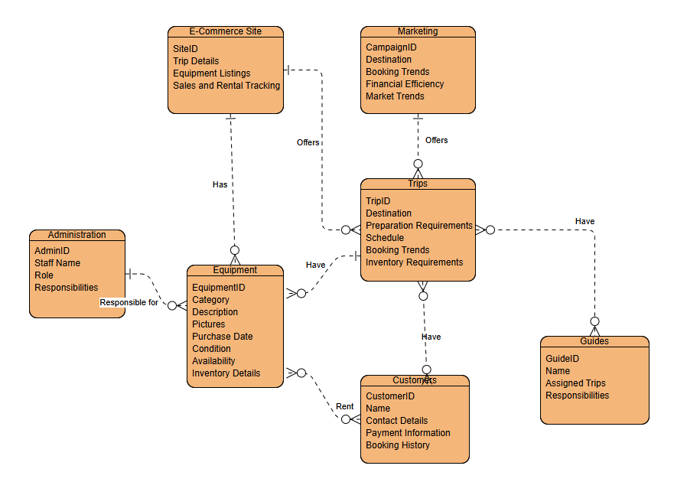
Finalized ERD (Entity Relationship Diagram)

Slide 5
Reports We Decided to Generate
To address the business needs of Outland Adventures, we created three key reports
Trip Booking Status Report:
Tracks which customers have completed their payments for bookings.
Equipment Availability Report:
Displays available rental equipment, helping to manage inventory.
Marketing Campaign Effectiveness Report:
Identifies which trips are in high demand, helping assess marketing success."
1
2
3

Slide 6
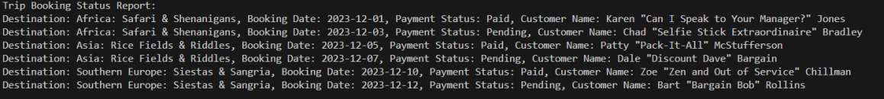
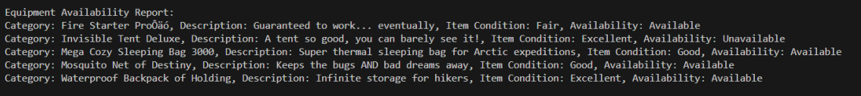
Example Report Results
-A table showing customer names, trip names, and payment status (e.g., "Paid" or "Pending").
Trip Booking Status Report:
1
Equipment Availability Report:
-A list of equipment with availability status and Item condition (e.g., "Available" or "Unavailable").
2
Marketing Campaign Effectiveness Report:
-A chart or table showing which trip is on demand (e.g., “Increasing” or “Decreasing”).
3

Slide 7
Assumptions & Design Decisions
To guide our database design, we made the following assumptions:
Customer Payment Status:
We assumed that customers are expected to complete their payments before their trips are confirmed. This assumption shaped the design of the Trip Booking Status Report, ensuring that we track customer payments accurately and reflect their booking status (paid or pending)."
Equipment Availability:
We assumed that the company manually tracks equipment availability, with no automated system for alerting when stock is low. This led us to design the Equipment Availability Report, which helps staff manually track and update equipment availability for rental.
High Trip Demand: We assumed that the trips offered by Outland Adventures are in high demand. This assumption influenced our Marketing Campaign Effectiveness Report, as we focused on analyzing the number of bookings and interest for each trip to assess marketing success.

Slide 8
continued…
Marketing Focused on Specific Trips Assumption: Marketing campaigns are designed around specific trips, and the number of bookings during a given period is a key measure of a campaign’s success. Impact on Design: The Marketing Campaign Effectiveness Report was designed to capture data on which trips are most popular, reflecting the success of marketing efforts. We focused on tracking bookings and customer interest by trip to measure the success of campaigns.
Customer Demographics and Preferences Are Stable Assumption: Customer preferences (such as favored trips and equipment) do not fluctuate rapidly. Impact on Design: This assumption allowed us to create relatively static reports and databases that focus on regular customer trends over time, rather than incorporating highly dynamic features or real-time updates.

